Slide 1

19AIE114 Principles of Measurements and Sensors PROJECT
BY
BATCH-11

Slide 2
TEAM MEMBERS:​
MENTA SAI AKSHAY [CB.EN. U4AIE20040]
S.V.S. DHANUSH [CB.EN. U4AIE20068]
SAI ARAVIND.V[CB.EN. U4AIE20062]

Slide 3

Coal Mine Safety Surveillance Bot

Slide 4
Aim:
The aim of our project is to tackle the problem of coal mine accidents which results in the death of several people every year. Most of the accidents are due to fire or gas and lack of a proper surveillance or rescue system. By implementing a Coal Mine Surveillance bot, which can move around unmanned in the mine and detect the temperature level, fires we can prevent major accidents. We can even use the bot to detect any human presence at the restricted area.

Slide 5

Components Used:
Arduino Uno
Breadboard
16*2 LCD display
Temperature Sensor
Gas sensor
Ultrasonic Sensor
PIR Sensor (Passive Infrared Sensor )
Piezo Buzzer
Hobby Gear Motor
H – Bridge motor driver

Slide 6
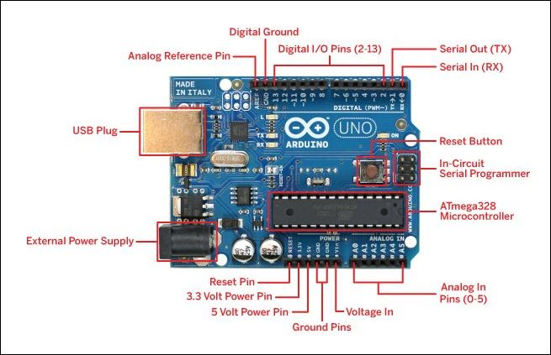
Arduino UNO
The Arduino Uno is an open-source microcontroller board based on the Microchip ATmega328P microcontroller and developed by Arduino.cc. The word "uno" means "one" in Italian and was chosen to mark the initial release of Arduino Software.

Slide 7
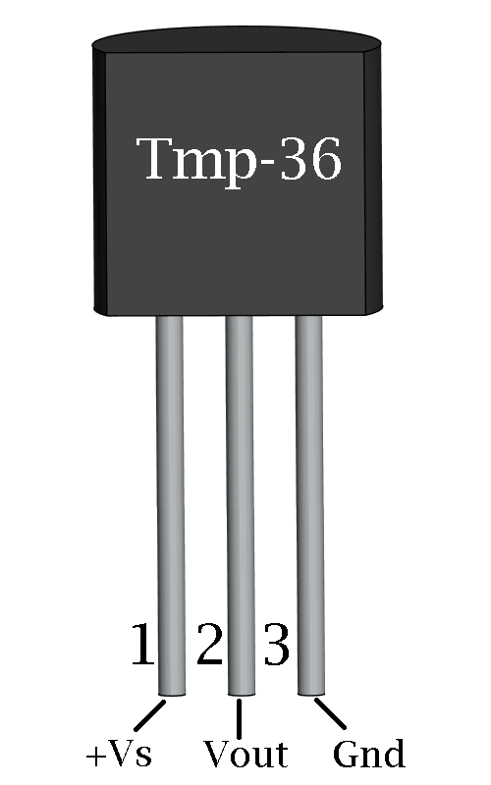
Temperature Sensor
A temperature sensor is a device used to measure temperature. There are different types of temperature sensors available, and they each use different technologies and principles to take the temperature measurement.
Vs pin is connected to voltage supply.
Vout pin is signal pin, it should be connected to Arduino.
Ground pin should be grounded.

Slide 8
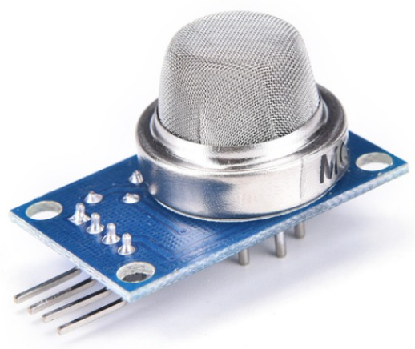
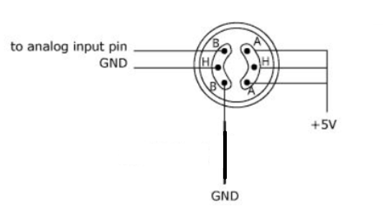
Gas Sensor
Gas sensors (also known as gas detectors) are electronic devices that detect and identify different types of gasses.
This type of sensor employs a chemiresistor which comes in contact and reacts with target gasses.
In our case we use MQ2 sensor which helps to detect gases like Methane, Butane, LPG, Smoke.

Slide 9
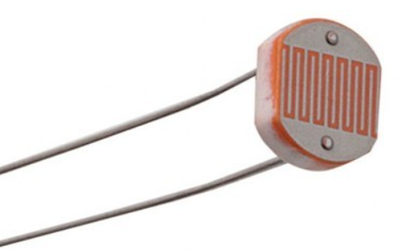

LDR Sensor
A Light Dependent Resistor (LDR) is also called a photoresistor.
It is also called a photoconductor.
It is basically a photocell that works on the principle of photoconductivity.
The passive component is basically a resistor whose resistance value decreases when the intensity of light decreases.

Slide 10
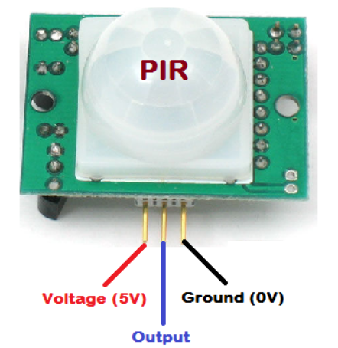
PIR Sensor
Passive infrared (PIR) sensors uses a pair of pyroelectric sensors to detect heat energy in the surrounding environment.
These two sensors sit beside each other, and when the signal differential between the two sensors changes (if a person enters the room, for example), the sensor will engage.

Slide 11
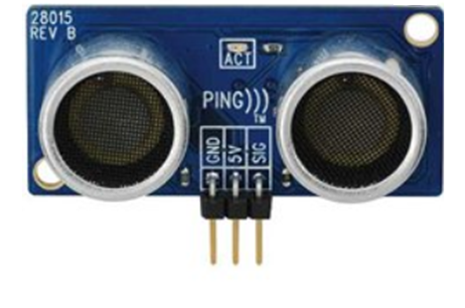
Ultrasonic Sensor
An ultrasonic sensor is an instrument that measures the distance of an object using ultrasonic sound waves. An ultrasonic sensor uses a transducer to send and receive ultrasonic pulses that relay back information about an object's proximity.
This signal pin is connected to Arduino (digital pin), this pin acts as both input and output pin (trigger and echo)

Slide 12
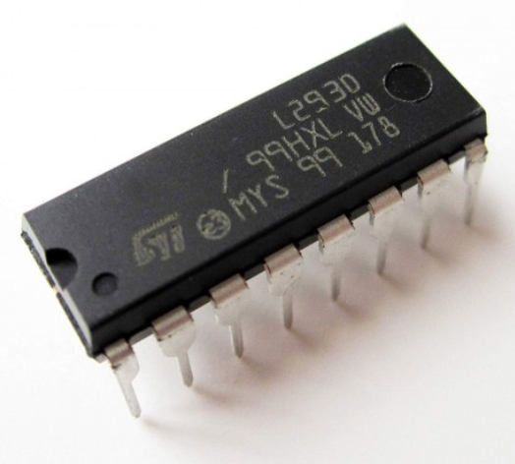
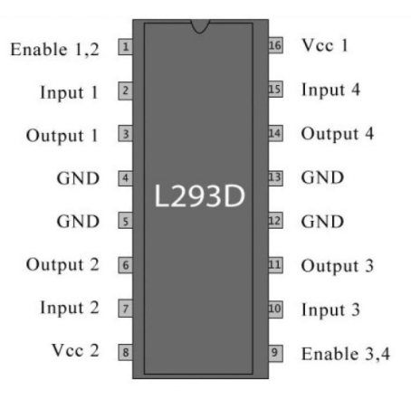
H - BRIDGE MOTOR DRIVER
A H bridge is an electronic circuit that allows a voltage to be applied across a load in any direction.
H-bridge circuits are frequently used in robotics and many other applications to allow DC motors to run forward & backward.
We will be using L293D Motor Driver.

Slide 13
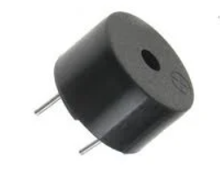

Piezo Buzzer
Piezo buzzer is a type of electronic device that's used to produce a tone, alarm or sound. It's lightweight with a simple construction, and typically a low-cost product.

Slide 14
HOW DO WE PROCEED ?
We have divided our project into two major parts:
A circuit which helps to find all the environmental parameters. In this part, we will try to find all the possible surrounding conditions in the mine like finding the temperature inside the mine, or whether there is any harmful smoke is detected and any fire accidents and light deficiency.
An autonomous bot circuit. In this part, we will be trying to make an autonomous bot which helps for autonomous surveillance, or we can even use this bot at the time of accidents when the surroundings are difficult for humans to enter.

Slide 15
PART – 1
MEASURING ENVIRONMENTAL PARAMETERS
CIRCUIT LINK

Slide 16
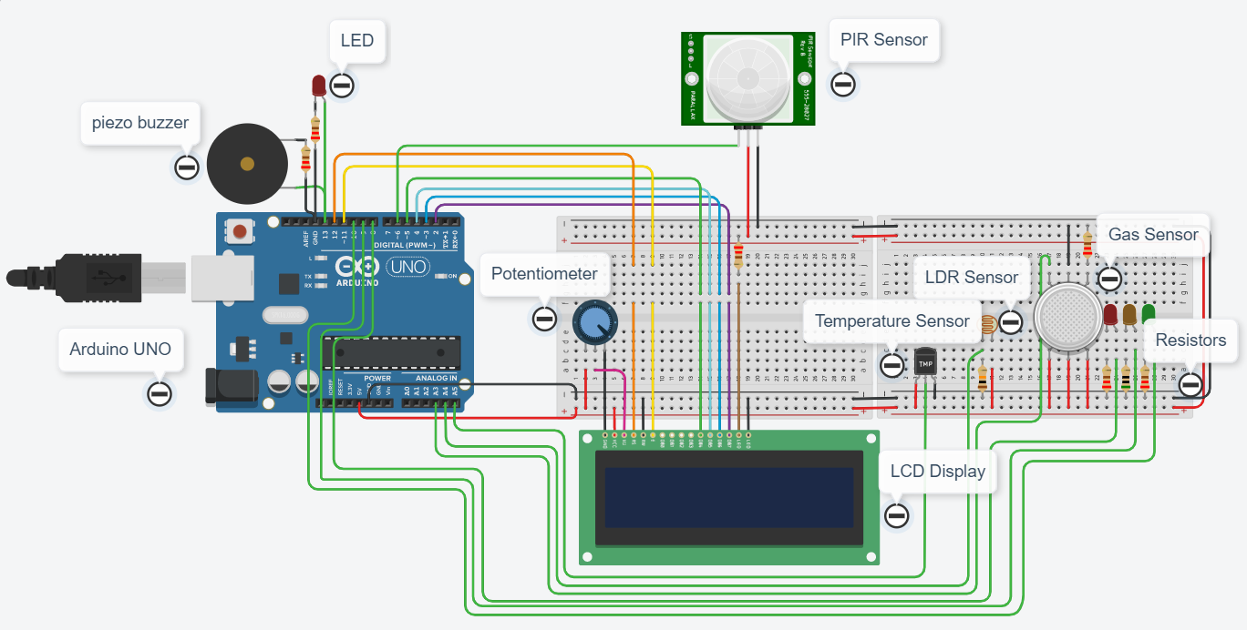
Circuit Diagram

Slide 17
WHAT DOES THE CIRCUIT DO AND HOW ?
FIRE DETECTION:
Whenever the temperature, light intensity is high and at the same time when the circuit detects high level dangerous smoke, we can consider fire is detected and then we will be giving a warning signal (Buzzer and warning light).
SMOKE DETECTION:
Depending on level of smoke we will be turning on the respective green, orange, red LED's and warning signal.
The circuit will also display the present surroundings temperature.
If the intensity of light is very less, we will notify to replace the bulb.
It alerts, when there is any trespassing in prohibited.

Slide 18
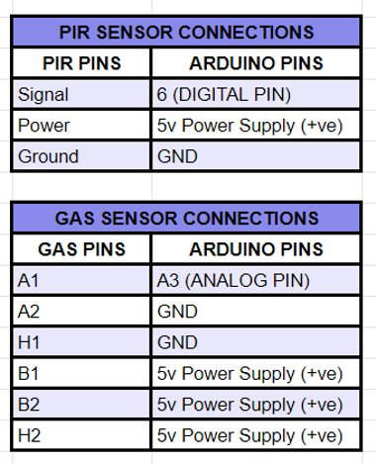
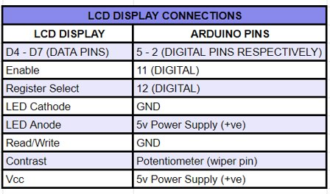
Procedure:
Add all the required components into the workspace of Tinkercad.
Connet the components as shown in the circuit diagram and with the help of pin mapping given below.

Slide 19
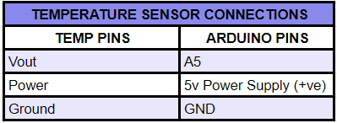
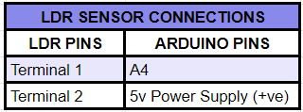

Slide 20
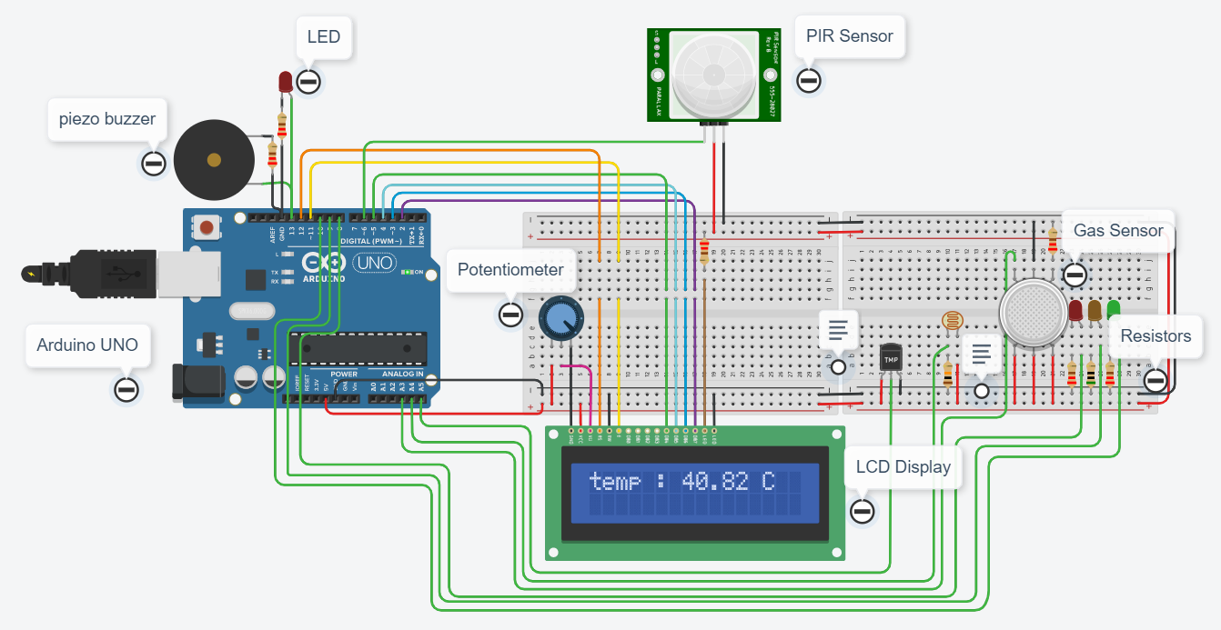
State of Circuit in Normal Conditions

Slide 21
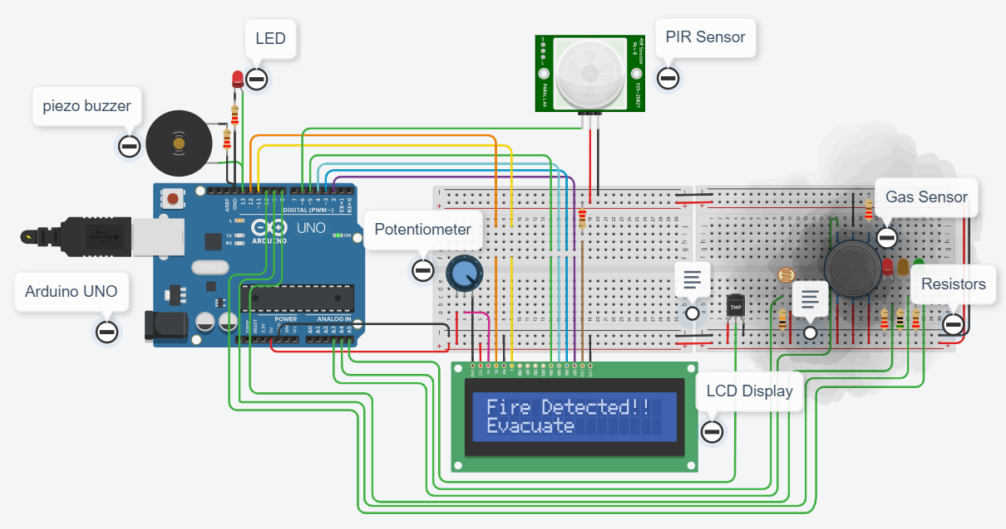
State of Circuit when Fire is detected

Slide 22
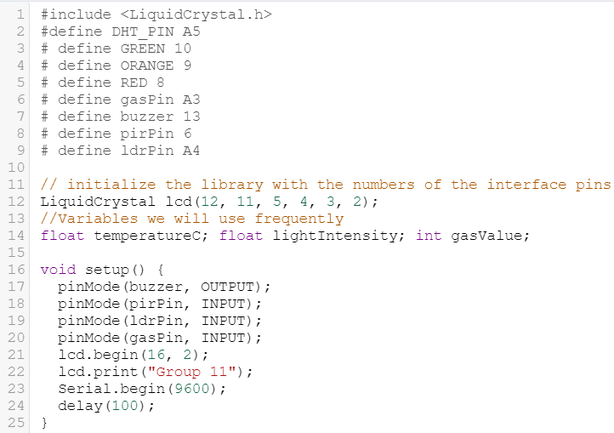
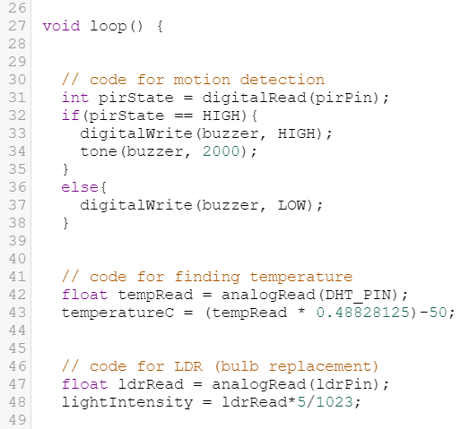
Code:

Slide 23
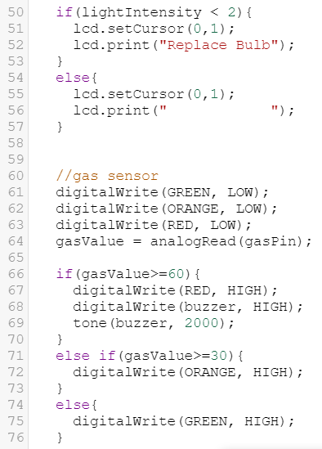
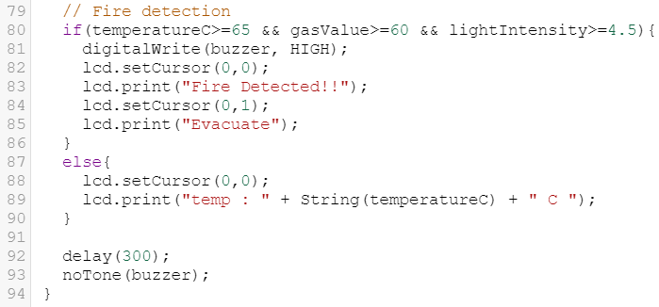

Slide 24
PART – 2
AUTONOMOUS BOT
CIRCUIT LINK

Slide 25
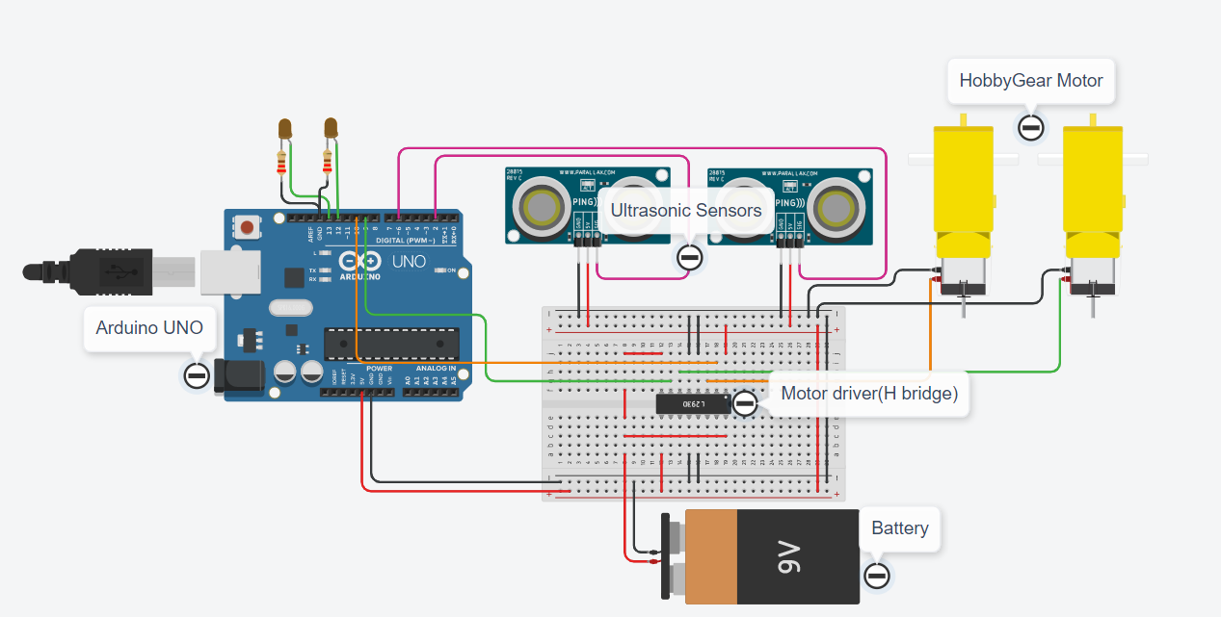
Circuit Diagram

Slide 26
WHAT DOES THE CIRCUIT DO AND HOW ?
This circuit helps the bot to avoid any obstacles during its motion.
HOW DOES IT TURN RIGHT OR LEFT ?
When it detects an obstacle from left side, the motor connected to the right wheel will stop rotating but the motor of the left wheel will continue to rotate.
As a net result of this action the bot will be turning to right and avoids the obstacle on the left side and vice versa in order to make the bot turn left.
If obstacles are detected on both side, We turn the bot to a side which has obstacle at far distance.

Slide 27
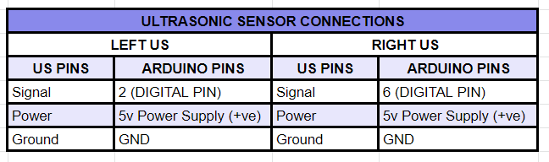
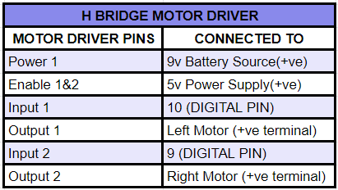
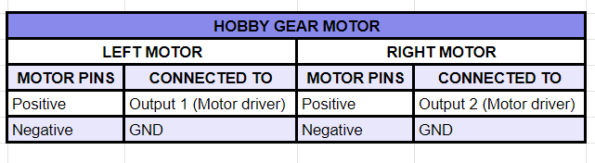
Procedure:
Add all the required components into the workspace of Thinkercad.
Connet the components as shown in the circuit diagram and with the help of pin mapping given below.

Slide 28
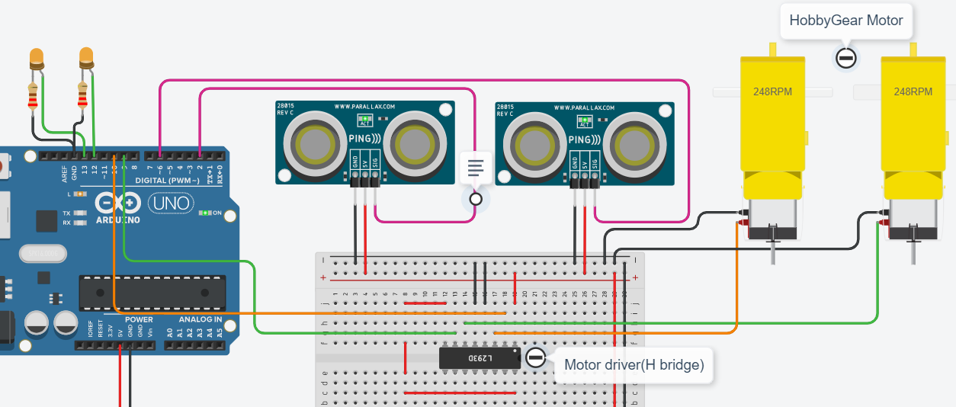
State of Circuit while moving Forward
The RPM of both the motors will be at 284 and both the LED's will glow indicating that it is moving forward.

Slide 29
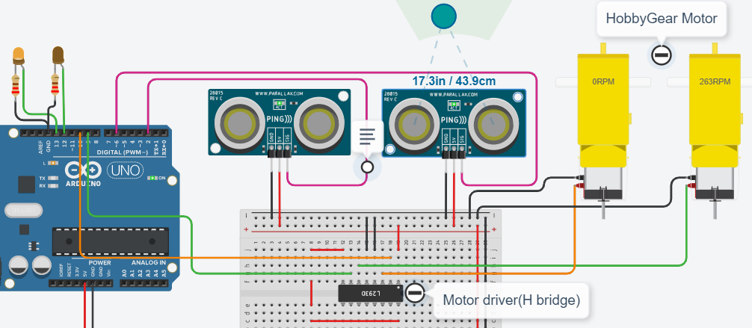
State of Circuit when turning Left
The RPM of left motor will become zero and the left LED will glow indicating that it is turning left.

Slide 30
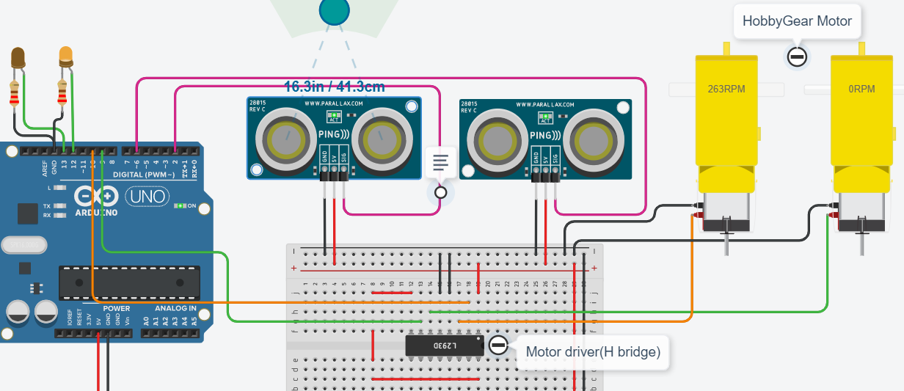
State of Circuit when turning Right
The RPM of right motor will become zero and the right LED will glow indicating that it is turning right.

Slide 31
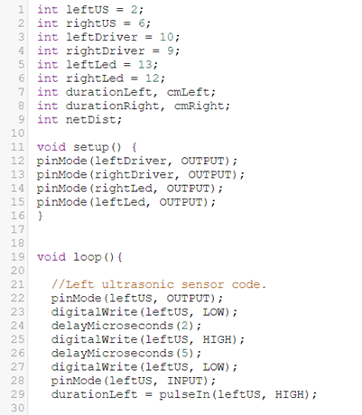
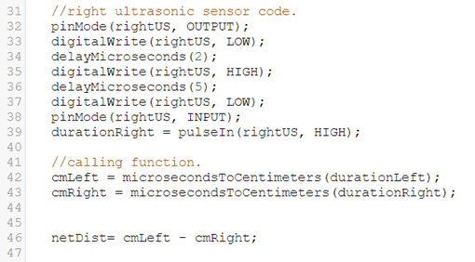
Code:

Slide 32
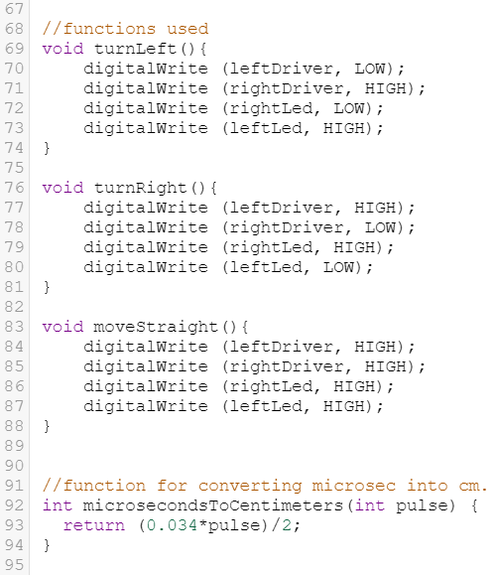


Slide 33
Conclusion:
We can use this project in two way.
As a Surveillance Bot.
As a stationary Surveillance Equipment.
With the help of IOT, We can improve the efficiency of the bot.
Monitor it from another place.
Get live Video Stream.
Get the location of the issue site.
Alert for Rescue Operations.
So, with the help of our project, We can closely monitor the mine 24/7 and avoid any disaster.

Slide 34

THANK YOU

